Slide 1
Malware in IEEE 802.11 Wireless Networks
Brett Stone-Gross*, Christo Wilson*,
Kevin Almeroth*, Elizabeth Belding*, Heather Zheng*,
and Konstantina Papagiannaki**
*Department of Computer Science,
University of California, Santa Barbara
**Intel Research
Pittsburgh, PA

Slide 2
Scenario
Connecting to a wireless LAN
Users have become accustomed to protection from
NATs
Firewalls
Worms and bots actively scan the Internet for vulnerable hosts
Identify machines via port scans
Attack/Exploit

Slide 3
Outline
Objectives
Motivation & Applicability
Experimental Setup
Identifying Malicious Flows
MAC Layer Impacts
Overall Impacts
Conclusions & Future Work

Slide 4
Objectives
To quantify, characterize, and correlate the effects of malicious traffic flows on a wireless LAN.
This is the first study to analyze these effects in a large-scale wireless network
More resource limitations
Bandwidth
Channel access

Slide 5
Motivation & Applicability
Improve quality of service offered by wireless networks
Assist in developing more realistic traffic models that account for malicious traffic
Applicable to almost any wireless network, especially those with lax security constraints including wireless hotspots
Substantiate the need for better wireless network protections

Slide 6
Experimental Setup
Data collection from the 67th IETF meeting in San Diego, California for a 5-day duration
44.7Mbps T3 backhaul link
Publicly routable subnet 130.129/16
No network address translation (NAT)
No firewall/MAC layer encryption
30 access points
802.11a/b/g
11 wireless packet sniffers
IBM/Toshiba laptops with Atheros chipsets
Wired and wireless traffic captured from a trunk port on the core router

Slide 7
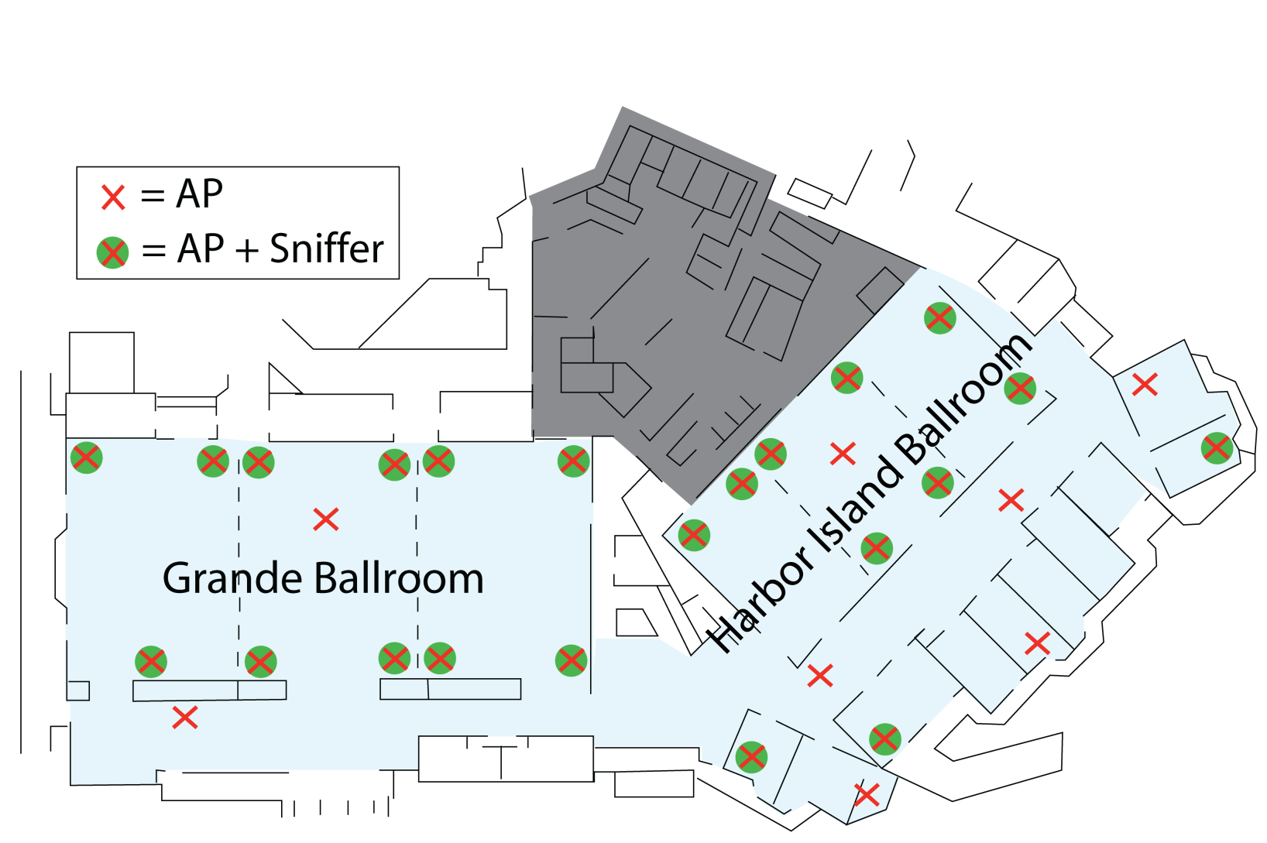
Wireless Sniffer Locations

Slide 8
Data Collection Statistics
Wired Data Set
Packet traces from all hosts over all 5 days
511GB uncompressed
Wireless Data Set
Packet traces from 11 concurrent access points
131 GB uncompressed
The wired data set was initially utilized to identify malicious flows and then matched with the smaller wireless data set

Slide 9
Detecting Malicious Flows
Port scanning & flooding
Large numbers of short-lived connections
TCP SYNs, ICMP ping
Well-known exploit signatures
Port-based
Malicious payloads
Since nearly all connected machines were laptops, unsolicited incoming connections to various services were easily identifiable

Slide 10
Most Common Malicious Flows
HTTP TCP SYN floods
NetBIOS/Microsoft Discovery Services exploits
SSH brute force dictionary attacks
MS SQL exploits

Slide 11
Malware-Driven Traffic Flows
TCP Statistics
Egress
4,076,412 out of 272,480,816 (1.5%) were classified as malicious
Ingress
2,765,683 out of 284,565,595 (1.0%) were classified as malicious
3,906 out of 109,740 unique external IP addresses (3.6%) engaged in malicious traffic flows
14 out of 1,786 internal IP addresses (0.8%) showed indications of malicious activity.
Network experts are more security conscious? ☺
At least one person was likely infected at the conference

Slide 12
Malicious Ingress Flows
Not ideal for studying the MAC layer effects
Attacks that involved only a few total packets
Few services were running on connected hosts (mostly laptops)
Natural load-balancing
Port scans that were distributed over hosts on all 30 access points
Backscatter from DoS attacks throughout the Internet that produced unsolicited TCP SYN ACKs, resets, and ICMP replies also distributed over all 30 access points

Slide 13
Malicious Egress Flows
Ideal for studying effects of malware attacks
All packets are broadcasted and processed by a single access point
Broadcasts impact nearby hosts
Channel Busy-time/Utilization
Packet collisions
Management frames
Data frames
Transmission rates
Auto-Rate Fallback (ARF) mechanism
Reduces transmission rates in favor of more robust modulation and coding schemes

Slide 14
MAC Layer Impact Summary
Increased
Number of data retransmissions
Channel utilization
Probe requests
Reduced
Transmission rates
11-18Mbps rates increased while 48-54Mbps rates decreased significantly
Probe responses

Slide 15
Case Study
ICMP ping in combination with a NetBIOS worm exploit that originated from a single machine on the wireless LAN
78,295 overall packets in about 18 minutes
Start: 17:02:38
End: 17:20:45
Attack halted for about 2 minutes at 17:09:00
Bursts of 235 packets per second
Average rate of 117 packets per second

Slide 16
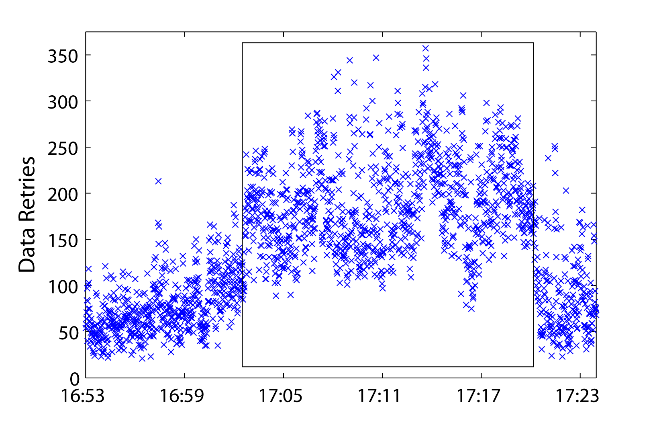
MAC Layer Impact-Data Retries

Slide 17
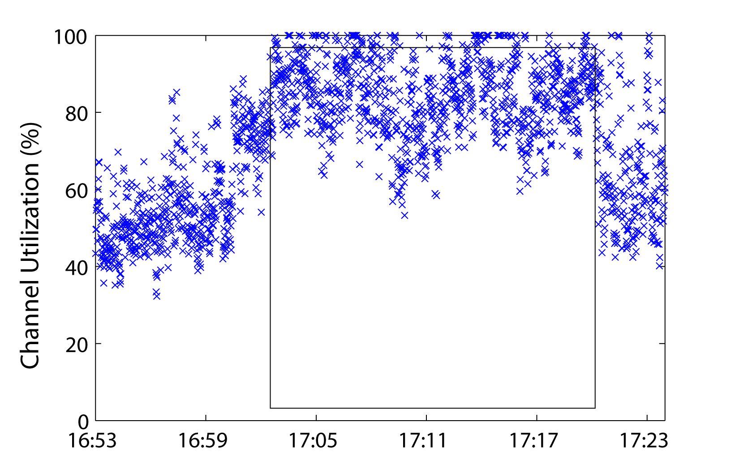
MAC Layer Impact- Channel Utilization

Slide 18
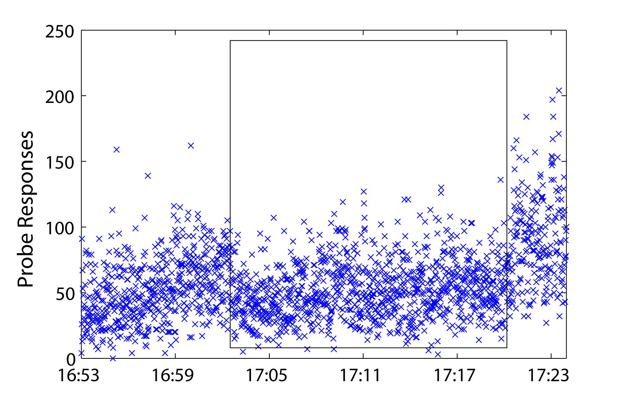
MAC Layer Impact-Probe Responses

Slide 19
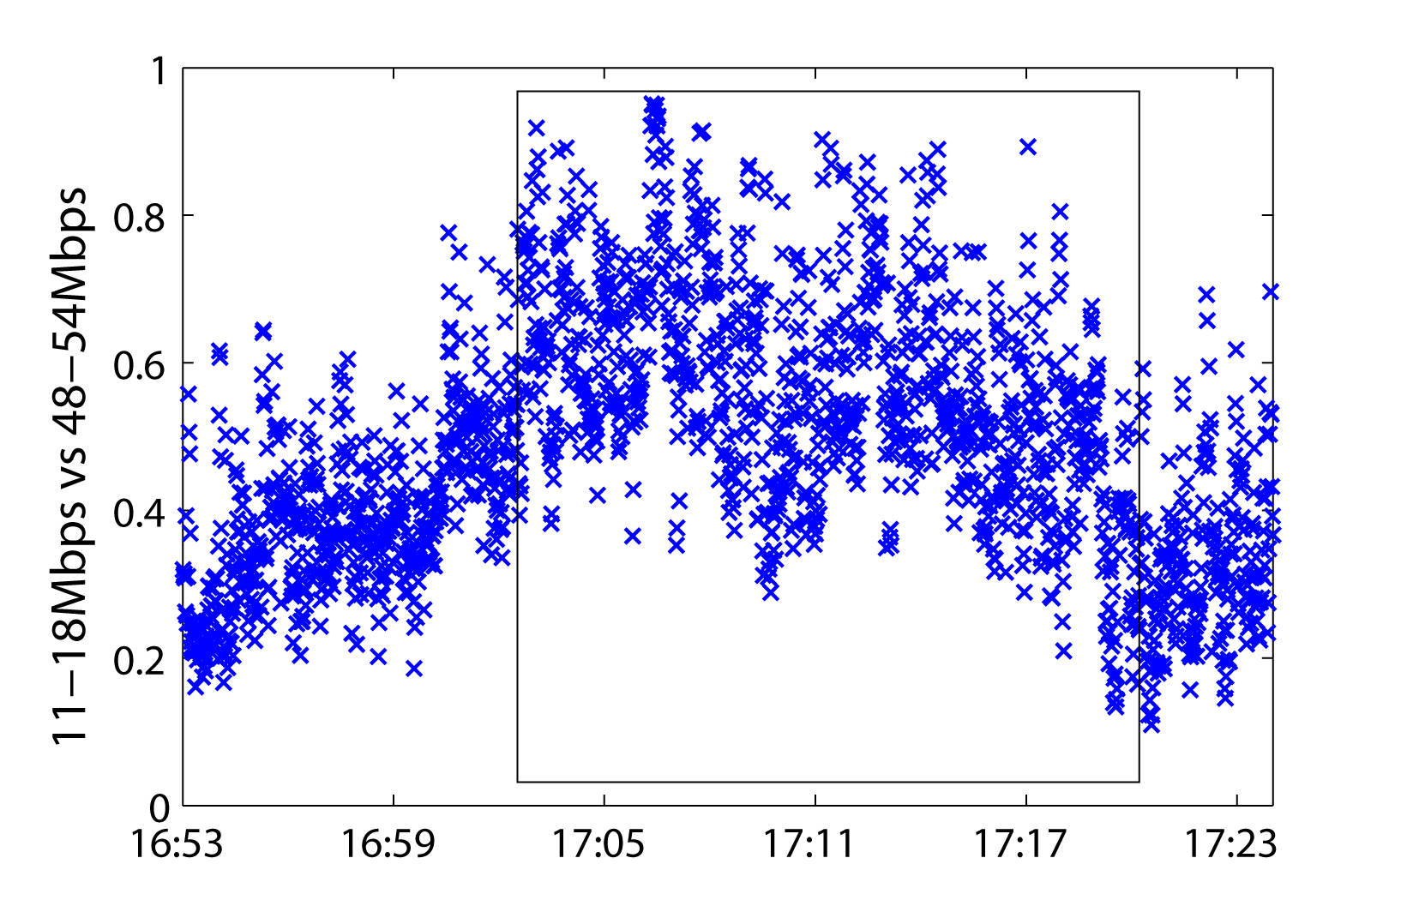
MAC Layer Impact- ARF Responses

Slide 20
Overall Impact
Increased round-trip-times (RTTs)
 | Non-Attack Interval | During Attack | Percent Increase
Average Egress | 64.7 ms | 99.2 ms | 53.2%
Avg Ingress | 23.4 ms | 36.1 ms | 54.4%
Median Egress | 41.6 ms | 85.0 ms | 104.3%
Median Ingress | 3.2 ms | 6.8 ms | 112.5%

Slide 21
Conclusions
Malicious traffic flows have a detrimental impact on wireless networks
MAC Layer
Latency/Round-trip-time
Auto-rate fallback is not optimal during congested intervals
The mechanism of probing for better connectivity may only increase overall network contention
Probe responses and other management frames may be blocked during periods of high channel utilization

Slide 22
Future Work
Aggregate statistics for similar data sets
IETF data sets
58th, 60th, 62nd, 64th
Trend Analysis
Malicious flows
Evolution of malware
Backscatter analysis
Network Protection Solutions
How to filter this traffic? How much of an impact will this make?
Traffic Modeling with Malicious Flows

Slide 23
Questions?
Contact Information
Email: bstone@cs.ucsb.edu

